Slide 1
Litigation Update
Jerry Bonanno
Deputy General Counsel
Nuclear Energy Institute

Slide 2
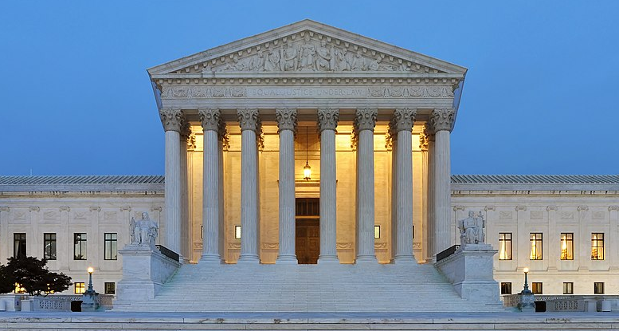
Pending Litigation in Context
Need for stable, predictable, efficient regulatory and legal frameworks
Need for rapid, foundational change to accommodate new technologies, business models and national policy priorities
Work affecting this balance is unfolding in policy and regulatory space, but also in the federal courts.

Slide 3
Important Issues Currently Being Litigated

Slide 4
NRC v. Texas, Nos. 23-1300, 23-1312 (SCOTUS review of Texas v. NRC, 78 F.4th 827 (5th Cir. 2023))
Issues
Does NRC have statutory authority to license private, away-from-reactor interim spent fuel storage installations (ISFSI)?
  Despite over 40 years of NRC licensing and regulating such facilities, 5th Cir. held NRC lacks such authority under the Atomic Energy Act and Nuclear Waste Policy Act
Who can seek judicial review of NRC licensing decisions?
  Application of “ultra vires” exception to Administrative Orders Review Act (Hobbs Act) by 5th Cir. allowed non-parties to challenge issuance of license
  Under Hobbs Act, does a “party aggrieved” by final NRC order = a party admitted to licensing adjudication before the agency?
Why does it matter?
Could challenge industry reliance on decades of consistent NRC regulatory and licensing precedent, as well as decisions by other circuit courts of appeal (i.e., D.C. Cir. and 10th Cir.) upholding agency’s authority to license such facilities
Could challenge industry reliance on NRC’s issuance of licenses and significant investment in costly and time-consuming licensing adjudications before the agency

Slide 5
Last Energy, et. al. v. NRC, E.D. TX (amended compliant filed 4/7/2025)
Issues
Facial challenge of nearly 70-year-old NRC final rule determining that all reactors meet the definition of “utilization facility” (UF)
  Plaintiffs assert NRC does not have authority under AEA to license certain reactors as UF
  Plaintiffs requesting vacatur and remand UF final rule and declaratory judgement that certain small modular/advanced reactors do not, as a matter of law, qualify as UF
Which federal courts have subject matter jurisdiction to hear challenges to final NRC rules?
  Challenges longstanding interpretation that final NRC final rules are “orders” under Hobbs Act, thus subject to direct review by federal courts of appeal
When must challenges to NRC final rules be brought?
  Within 60-days of issuance of final rule under Hobbs Act vs. within 6-years of accrual of claim under Administrative Procedure Act?
Why does it matter?
Raises valid questions about whether all reactors, including micro-reactors currently being contemplated, should be defined/licensed as UF
But method of challenging the NRC’s UF rule raises several concerns – e.g., . . .
  Impacts on regulatory stability
  Inefficiency and increased cost associated with litigating facial challenges to final rules in district court
  Inefficiency of bringing issues involving application of agency technical judgement directly to district courts, without first bringing them to the agency (via petition for rulemaking, exemption request, etc.)
  Cloud division of responsibility between state and federal government with respect to licensing and regulation of commercial reactors

Slide 6
Mazzocchio v. Cotter, 2024 WL5151074 (8th Cir. 2024)(Pet. for Cert. pending)
Issues
What is “standard of care” in public liability actions seeking compensation for injuries/property damage resulting from nuclear incidents under the Price-Anderson Act (PAA)?
  8th Circuit allows standards of care imposed under state tort law, as opposed to federal regulatory standards, to establish standard of care in PAA public liability actions
  Split with five other circuits (3d, 6th, 7th, 9th, 11th), which have held that standard of care set by federal requirements preempt those established under state tort law
  Under Mazzocchio, before-the-fact regulation of nuclear safety reserved to federal government, but standards of care established by lay juries through ex post tort judgements
Why does it matter?
Could create significant regulatory uncertainty for both existing operators, investors/developers, and suppliers
  Instead of single, predictable regulatory baseline for nuclear safety – the federal baseline, which changes only prospectively – could require operators to anticipate what lay juries may impose years or decades after-the-fact
  Could impose standards under state tort law that will vary and could even include imposition of strict liability
Strikes at core of the preemption framework governing regulation of nuclear safety, creating a split between ex ante regulation (reserved to NRC) and ex post regulation (now potentially imposed by juries)
Expert regulatory agency in best position balance competing set of values when setting safety standards – technical feasibility, the need to minimize radiation exposure, economic costs, etc.

